Slide 1

R.N.G Patel Institute Of Technology
SUBJECT: Data Visualization And Analytics | CODE: 1IT508
BANK MARKETING
ANALYTICS
PEN NO: 250843116003
250843116009
250843116015
240840116102
GROUP NAME: Tech Queens

Slide 2
01 | Dataset Observations
Understanding the Bank Marketing dataset
Dataset size
Target variable
Data types
11,162 customer records
17 columns
deposit = yes / no
Predicts term-deposit subscription
Numerical: age, balance, duration, campaign
Categorical: job, education, month, poutcome
• Customer details include age, job, marital status and education.
• Campaign details include contact method, month, duration and number of contacts.
• pdays = -1 indicates the customer was not previously contacted.
• Negative balances can be valid and should not be removed automatically.
• The dataset supports analysis of subscription patterns across customer groups.

Slide 3
02 | Data Preprocessing & Cleaning
Steps used to prepare the data for analysis
1. Load & inspect
2. Check missing values
3. Check duplicates
4. Validate data types
Check rows, columns, sample records and data types.
Check repeated rows. But have no duplicate values
Ensure numeric and categorical fields are correctly typed.
Identify null or blank values in each column. Found 0 missing values
5. Check unusual values
6. Validate & export
Review age, balance, campaign and duration for invalid entries.
Recheck cleaned data and save a new CSV for Power BI.

Slide 4
03 | Final Clean Dataset
What the cleaned dataset is used for
Clean structure
Reliable records
Analysis-ready target
Consistent columns and data types
Ready for analysis
Duplicates and invalid entries reviewed
Missing/unknown values assessed
deposit = yes / no
Used to compare subscription outcomes
• The final dataset is imported into Power BI.
• Customer and campaign fields group subscription outcomes.
• The deposit column is used to calculate subscription counts and rates.
• The cleaned CSV is saved separately so the original data remains unchanged.

Slide 5
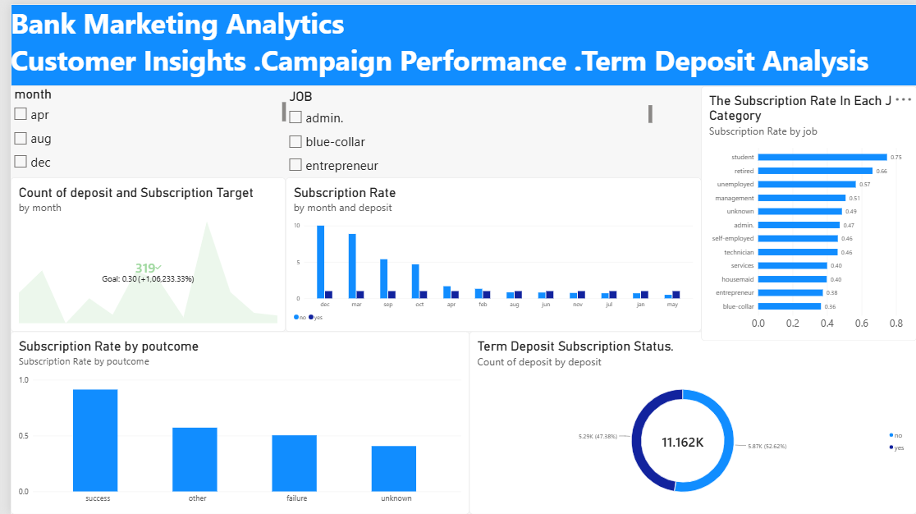
04 | Power BI Dashboard
Bank Marketing Analytics — customer and campaign insights

Slide 6
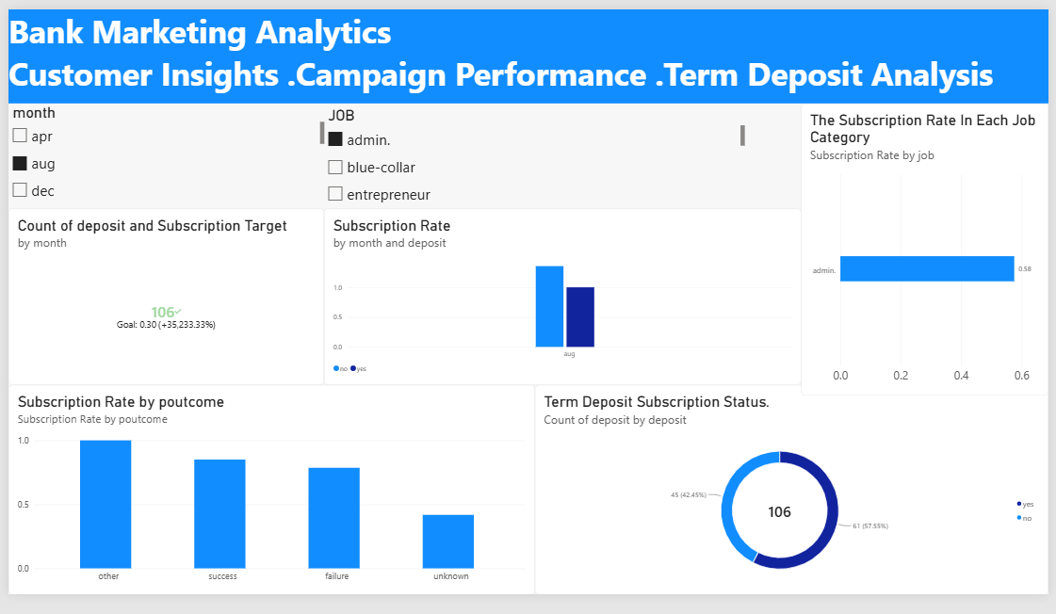
04 | Power BI Dashboard
Bank Marketing Analytics — customer and campaign insights

Slide 7
05 | Dashboard Observations & Insights
What the current visuals suggest
Previous campaign outcome
Job categories
The success category has the highest subscription rate in the displayed chart.
Student and retired categories appear among the higher subscription-rate groups.
Subscription status
Monthly pattern
The donut shows a near-even split between yes and no; yes is slightly lower in this view.
Monthly results vary; confirm that the visual shows subscription rate rather than raw counts.
Insights are based on the screenshot. Verify chart field settings and calculations before presenting exact rates.

Slide 8
THANK YOU
Bank Marketing Analytics

